Slide 1
TEXT ANALYTICS of
FINANCE & TECHNOLOGY NEWS
—— Project Proposal Text Analytics Spring 2019
Group 3 (11 am):
Li Kang, Qiaoye Zhang, Yeqing Xia, Xuming Wang, Meng Qi

Slide 2

PROBLEM STATEMENT:
Brief Background of the Topic
Nasdaq is a global electronic marketplace for buying and selling securities, as well as the benchmark index for U.S. technology stocks;
Identifying Investor sentiment and quantifying the impact of sentiment on stock prices is an important topic.
Notes:
Sources:
the importance of fear: investor sentiment and stock market returns
https://www.tandfonline.com/doi/abs/10.1080/00036846.2016.1259754

Slide 3
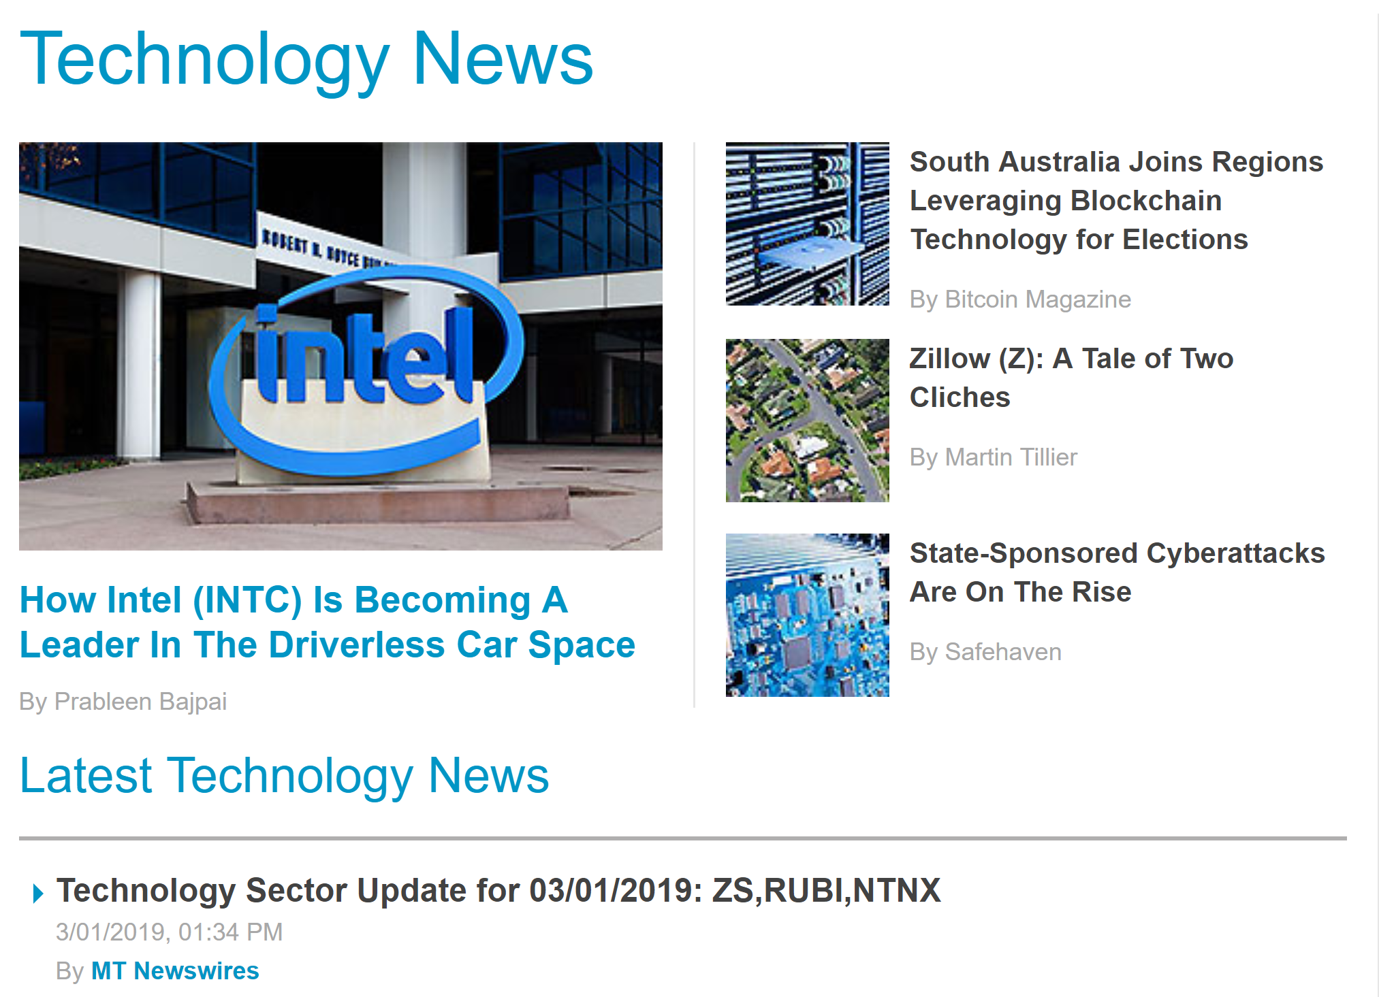
PROBLEM STATEMENT
What are recent hot topics?
What can we further explore with a company news?
Stock Price reflection
Notes:
Sources: https://www.nasdaq.com/tech/
what exactly do you propose to do?

Slide 4
PROBLEM STATEMENT
News is very important because we can use it to forecast events in the future;
The sooner you hear news before the market, the better chance you have of getting in ahead of any price movements;
Stock market news is vital and helps investors with stock picking as they can judge what to expect from the news
Notes:
Why important and interesting
Sources: https://www.nasdaq.com/tech/

Slide 5
PROBLEM STATEMENT:
Hypothesis
If the news articles about a tech company have negative sentiment scores, this company’s stock prices would probably decrease.
The “hot topic” technology companies are more likely to have increasing trend for their stock prices.
Companies with similar topics of their news articles and sentiment score would have similar trends of their stock prices.
Notes:
Sources: https://www.nasdaq.com/tech/

Slide 6
METHODOLOGY:
Roadmap
Recent Hot Topics
Word Cloud
Finance News
NASDAQ.com
Information Extraction/ Topic Modeling
Classification
Based on Company
Sentiment Analysis
Based on Company Stock
Predication
Stock Price

Slide 7
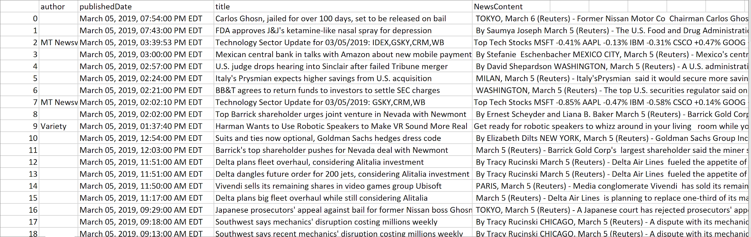
DATA COLLECTION
Technology News within one month
BeautifulSoup Crawler
Notes:
https://www.nasdaq.com/topic/technology

Slide 8
METHODOLOGY:
Data Preprocessing
Tokenize news articles and generate BOW and n-gram words for further analysis
Stopwords removing, stemming
Generate word vector for further model use

Slide 9

METHODOLOGY:
Model Building
Information Extraction:
Python Packages: spaCy, Gensim, NLTK, Scikit-Learn
Topic Generation: Word Cloud
Sentiment Analysis:
NLTK Vader, TEXTBLOB
Text Classification
Text Clustering

Slide 10
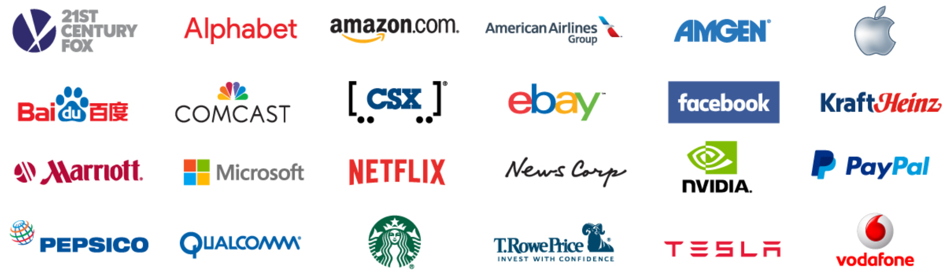
METHODOLOGY:
Evaluation
Cross comparison of sentiment analysis results with trend of stock prices for each tech company

Slide 11
EXPECTED RESULT & CONCLUSION
Reflect company stock price using sentiment analysis results
Popular topics in finance and technology industry
Relationship between sentiment analysis results of the news articles and trend of stock prices
“Most talked” companies and its stock price performances

Slide 12
PROJECT TIMELINE
Phase 3: Data Visualization, Results, and Conclusions
Visualize results of analysis and summarize our main findings. Make predictions for trend of stock prices with the results.
Phase 1: Data Collection
Crawl news articles from NASDAQ.com technology news.
03/31/2019
04/24/2019
03/15/2019
04/15/2019
Phase 2: Data Preprocessing, modeling, and Analysis
Clean data crawled and perform analysis mentioned previously in Methodology.
Final Presentation
Finalize report and presentation slides.

Slide 13
Thank You!

